Slide 1
BREAST CANCE PREDICTION
USING ML
GUIDED BY:
DR.K.MUTHUKANNAN
Dhanush-P(732721205012)
Ravichandran-N(732721205043)
Surya-S(732721205052)
Sandip Mondal(732721205047)

Slide 2
ABSTRACT
Breast cancer is considered a multi-factorial disease and the most common cancer in women worldwide with approximately 30% of all female cancers (i.e. 1.5 million women are diagnosed with breast cancer each year , and 500,000 women die from th Over the past 30 years, this disease has increased, while the death rate has decreased. However, the reduction in mortality due to mammography screening is estimated at 20% and improvement in cancer treatment is estimated at 60%.

Slide 3
INTRODUCTION
SUPPORT VECTOR MACHINE(SVM)
Support Vector Machine (SVM) is a powerful machine learning algorithm used for linear or nonlinear classification , regression , and even outlier detection tasks. SVMs can be used for a variety of tasks, such as text classification , image classification, spam detection, handwriting identification, gene expression analysis, face detection, and anomaly detection.

Slide 4
LITERATURE REVIEW
Cancer Prediction by the Priyanka Gandhi and Prof. ShaliniL of VIT university, vellore. In this paper, ML techniques are explored in order to boost the accuracy of diagnosis.Methods such as CART, Random Forest, K-NearestNeighbours are compared. The dataset used is acquiredfrom UC Irvine Machine Learning Repository. It is foundthat KNN algorithm has much better performance than the other techniques used in comparison. The most accurate model was K-Nearest Neighbour. The classification modelsuch as Random Forest and Boosted Trees showed the similar accuracy. Therefore, the most accurate classier canbe used to detect the tumour so that the cure can be foundin early stage.

Slide 5
Breast Cancer Prediction Using Genetic Algorithm Based
Ensemble Approach written by Pragya Chauhan and Amit Swami proposed a system where they found that Breastcancer prediction is an open area of research. In this paper dierent machine learning algorithms are used for detection of Breast Cancer Prediction. Decision tree, random forest,support vector machine, neural network, linear model,adabost, naive bayes methods are used for prediction.
S.Sidhu As investigated the performance of Support Vector Machine, Artificial Neural Network and Naïve Bayes using the Wisconsin Diagnostic Breast Cancer (WDBC) Dataset by integrating these machine leaning techniques with feature selection/feature extraction methods to obtain the most suitable one. The simulation results showed that SVM-LDA was chosen over all the other methods due to their longer computational time.

Slide 6
FEATURES
1.Radius (mean of distances from center to points on the perimeter)
2.Texture (standard deviation of gray-scale values)
3.Perimeter
4.Area
5.Smoothness (local variation in radius lengths)
6.Compactness (perimeter² / area — 1.0)
7.Concavity (severity of concave portions of the contour)
8.Concave points (number of concave portions of the contour)
9.Symmetry
10.Fractal dimension (“coastline approximation” — 1)

Slide 7
Understanding For Algorithm
Support Vector Machine (SVM)
The objective of the support vector machine algorithm is to find a hyperplane in an N-dimensional space (N — the number of features) that distinctly classifies the data points. To separate the two classes of data points, there are many possible hyperplanes that could be chosen. The objective is to find aplane that has the maximum margin,i.e the maximum distance between data points of both classes.

Slide 8
Hyperplanes are decision boundaries that help classify the data points. Data points falling on either side of the hyperplane can be attributed to different classes. Also, the dimension of the hyperplane depends upon the number of features.
Support vectors are data points that are closer to the hyperplane and influence the position and orientation ofthe hyperplane. Using these support vectors, we maximize the margin of the classifier. Deleting the support vectors will change the position of the hyperplane
SVM clearly is the most effective classifier of all as it worksreally well with clear margin of separation and high dimensional data, but is not suitable for large data sets because the required training time is higher and also,
underperforms when the data set has more noise.

Slide 9
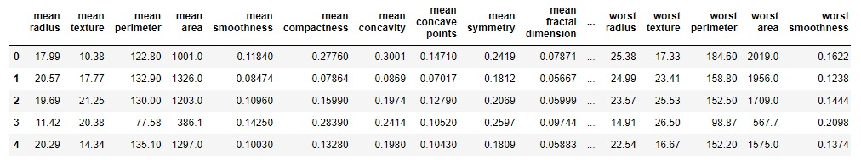
DATASET
The data used for the experiments was acquired from Kaggle. This dataset is Break Hist_Dataset consisting of four directories representing the magnification of the images respectively i.e. 100X, 200X, 400X and 40X.The dataset consists of 7,858 instances in total which are divided into the four magnification directories. Each magnification directory consists of two directories representing the tumours i.e. Benign and Malignant.

Slide 10
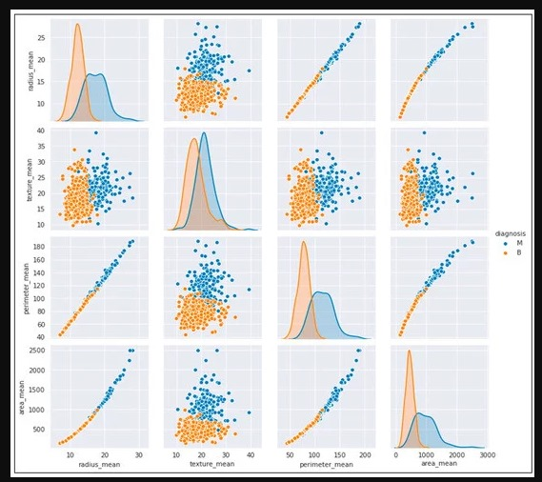
visualization
Benign
When a tumor is diagnosed as benign, doctors will usually leave it alone rather than remove it. Even though these tumors are not generally aggressive toward surrounding tissue, occasionally they may continue to grow, pressing on other tissue and causing pain or other problems. In these situations, the tumor is removed, allowing pain or complications to subside.
Malignant
Malignant tumors are cancerous and may be aggressive because they invade and damage surrounding tissue. When a tumor is suspected to be malignant, the doctor will perform a biopsy to determine the severity or aggressiveness of the tumor.

Slide 11
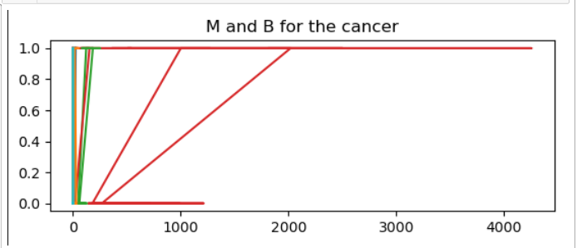
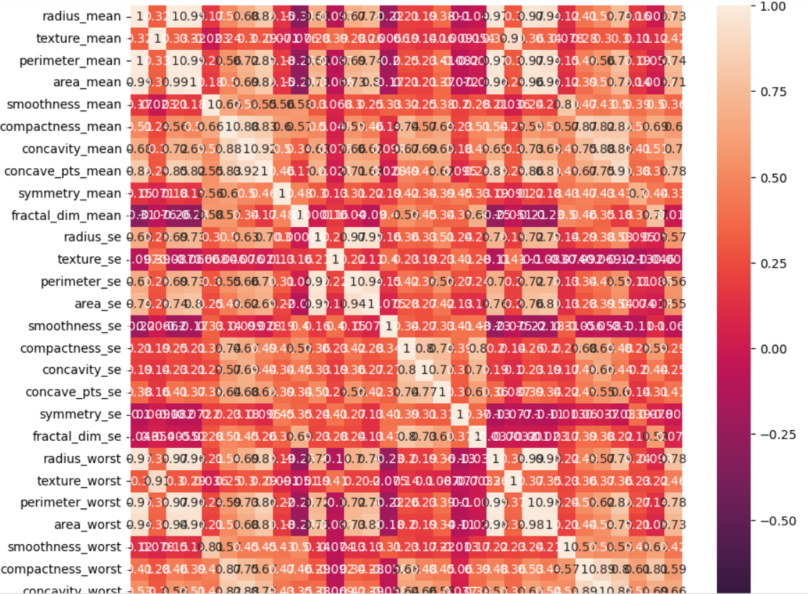
MODELING
We created a SVM model to train our model and create a model.

Slide 12
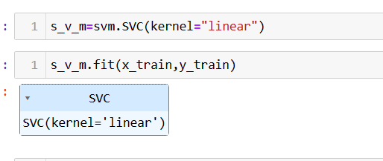
SAMPLE CODING
predict1=s_v_m.predict(x_train)
acc=accuracy_score(y_train,predict1)
print(acc)
predict2=s_v_m.predict(x_test)
acc2=accuracy_score(y_test,predict2)
print(acc2)

Slide 13
CONCLUSION
Breast cancer if found at an early stage will help save lives of thousands of women or even men. These projects help the real world patients and doctors to gather as much information as they can. The research on nine papers has helped us gather the data for the project proposed by us. By using machine learning algorithms we will be able to classify and predict the cancer into being or malignant.

Slide 14
THANK YOU

Slide 15
ANY QUERIES

